Slide 1
Properties of the Integers: Mathematical Induction
Chapter 4
1. Mathematical Induction
2. Harmonic, Fibonacci, Lucas Numbers
3. Prime Numbers

Slide 2
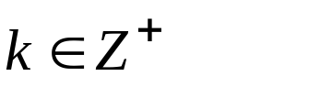
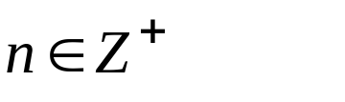
Chapter 4 Properties of the Integers: Mathematical Induction
4.1 The Well-Ordering Principle: Mathematical Induction
The Well-Ordering Principle Any nonempty subset of Z⁺
contains a smallest element. (We often express this by saying
that Z⁺ is well ordered.)
This principle serves to distinguish Z⁺ from Q⁺ and R⁺.
Theorem 4.1 Finite Induction Principle or Principle of
Mathematical Induction
S(n): an open statement, n a positive integer
If
(a) If S(1) is true; and /* basis, not necessarily from 1 */
(b) If whenever S(k) is true (for some ), then S(k+1)
is true; (inductive step)
then S(n) is true for all

Slide 3
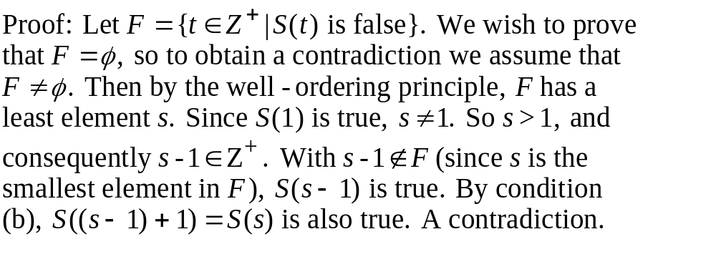
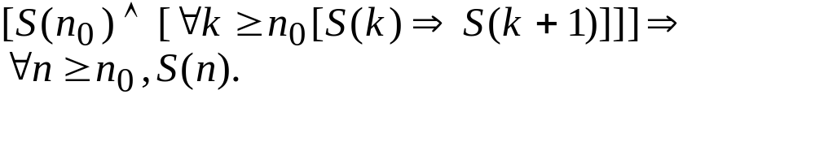
Chapter 4 Properties of the Integers: Mathematical Induction
4.1 The Well-Ordering Principle: Mathematical Induction

Slide 4
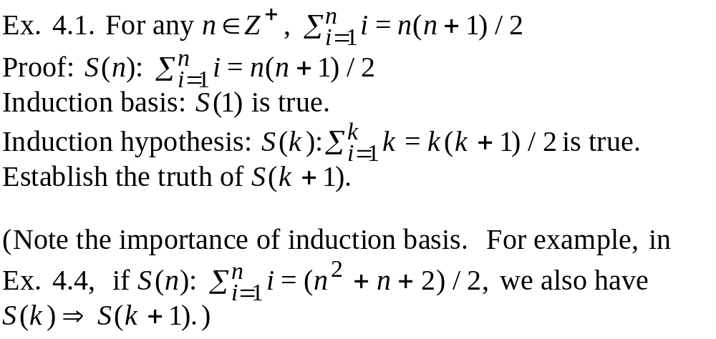
Chapter 4 Properties of the Integers: Mathematical Induction
4.1 The Well-Ordering Principle: Mathematical Induction

Slide 5
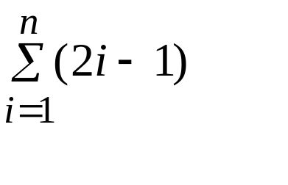
Chapter 4 Properties of the Integers: Mathematical Induction
4.1 The Well-Ordering Principle: Mathematical Induction
Ex. 4.5 Find a formula for
Ans: Observe and conjecture.
n=1 1 1=1²
n=2 1+3 4=2²
n=3 1+3+5 9=3²
n=4 1+3+5+7 16=4²
conjecture:
=n²
then prove by induction

Slide 6
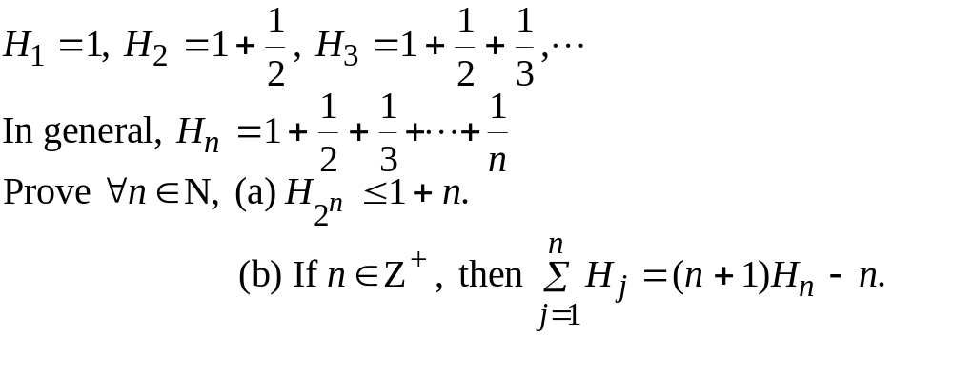
Chapter 4 Properties of the Integers: Mathematical Induction
4.1 The Well-Ordering Principle: Mathematical Induction
Ex. 4.7 the Harmonic Numbers

Slide 7
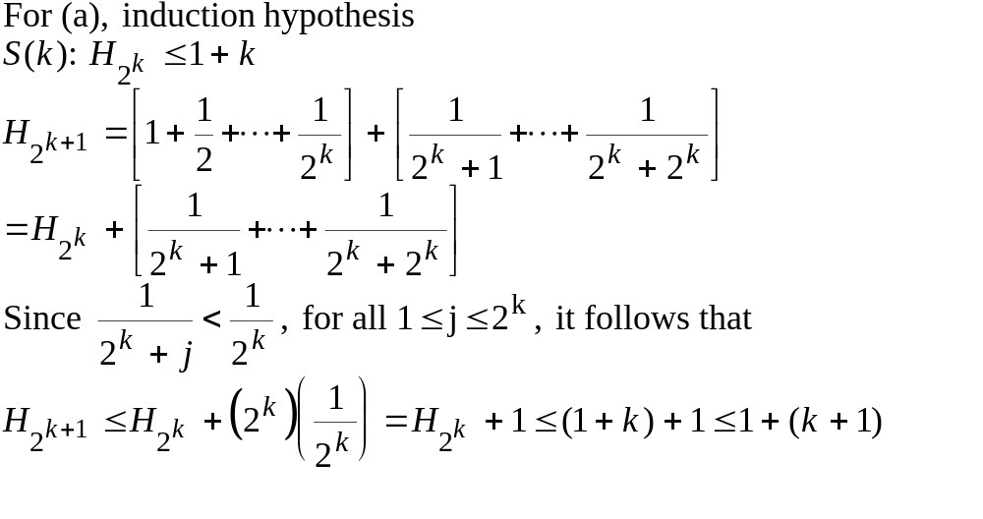
Chapter 4 Properties of the Integers: Mathematical Induction
4.1 The Well-Ordering Principle: Mathematical Induction
Ex. 4.7 the Harmonic Numbers

Slide 8
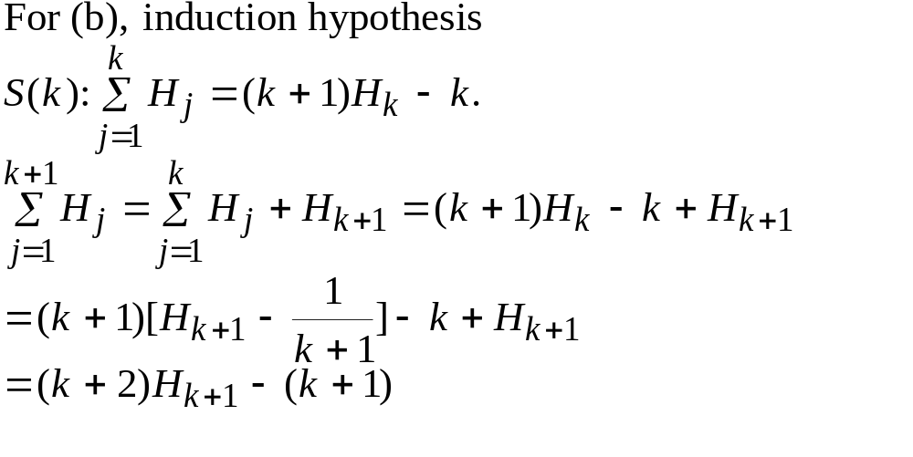
Chapter 4 Properties of the Integers: Mathematical Induction
4.1 The Well-Ordering Principle: Mathematical Induction
Ex. 4.7 the Harmonic Numbers

Slide 9
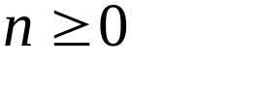
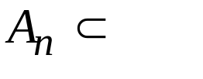
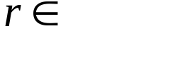
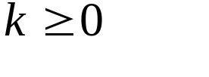
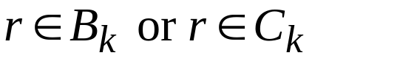
Chapter 4 Properties of the Integers: Mathematical Induction
4.1 The Well-Ordering Principle: Mathematical Induction
Ex. 4.8 For let R, where |A_{n}|=2^{n} and the elements of
A_{n} are listed in ascending order. If R, prove that in order to
determine whether A_{n}, we must compare r with no more than
n+1 elements in A_{n}.
Proof: When n=0, A₀={a} and only one comparison is needed.
Assume the result is true for some and consider the case
for A_{k+1}.
Let
and B_{k} < C_{k}
1
(1) Compare once to determine whether
k+1
k+2
(2) Then compare in B_{k} or in C_{k}
Total comparisons

Slide 10
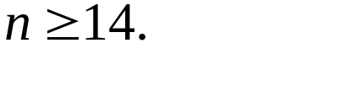
Chapter 4 Properties of the Integers: Mathematical Induction
4.1 The Well-Ordering Principle: Mathematical Induction
Ex. 4.10 Prove S(n): n can be written as a sum of 3's and/or 8's
(with no regard to order) for any
basis: n=14=3+3+8 OK
induction hypothesis: k can be added up by 3's and/or 8's.
If k=...+8+..., then k+1=...+3+3+3+...
Otherwise, there are at least 5 3's in k's summands.
k+1=...3+3+3+3+3+1+...=...8+8+...

Slide 11
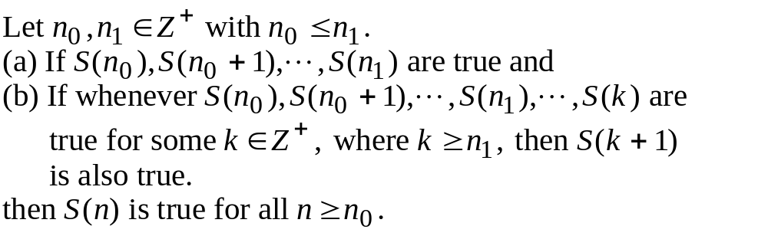
Chapter 4 Properties of the Integers: Mathematical Induction
4.1 The Well-Ordering Principle: Mathematical Induction
Theorem 4.2 Finite Induction Principle--Alternate Form

Slide 12
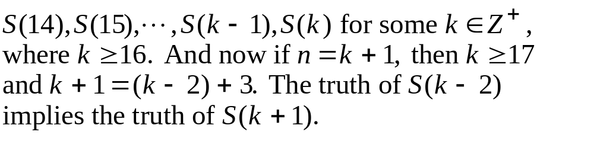
Chapter 4 Properties of the Integers: Mathematical Induction
4.1 The Well-Ordering Principle: Mathematical Induction
Ex. 4.11 Prove S(n): n can be written as a sum of 3's and/or 8's
(with no regard to order) for any
Assume the truth of the statements:

Slide 13
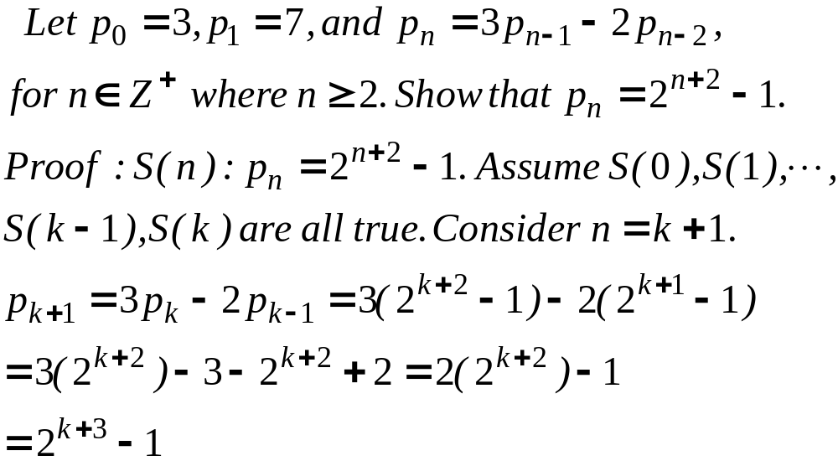
Chapter 4 Properties of the Integers: Mathematical Induction
4.1 The Well-Ordering Principle: Mathematical Induction
(recurrence relation)

Slide 14
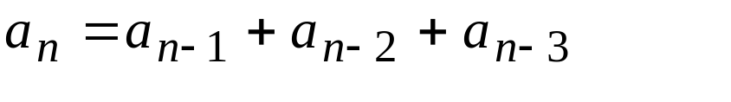
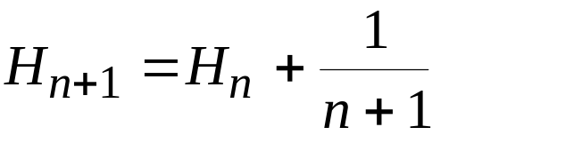
Chapter 4 Properties of the Integers: Mathematical Induction
4.2 Recursive Definitions
0,2,4,6,8,10,12,...: b_{n}=2n
1,2,3,6,11,20,37,68,125,...:a_{n}=?
explicit definition
implicit recursive
definition
Examples:
factorial: (n+1)!=(n+1)(n!)
Harmonic Number:

Slide 15
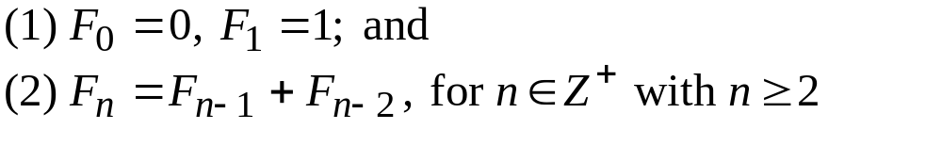
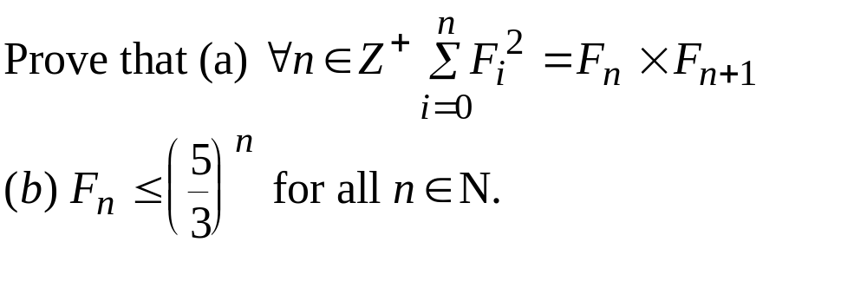
Chapter 4 Properties of the Integers: Mathematical Induction
4.2 Recursive Definitions
Ex. 4.16 The Fibonacci Numbers

Slide 16
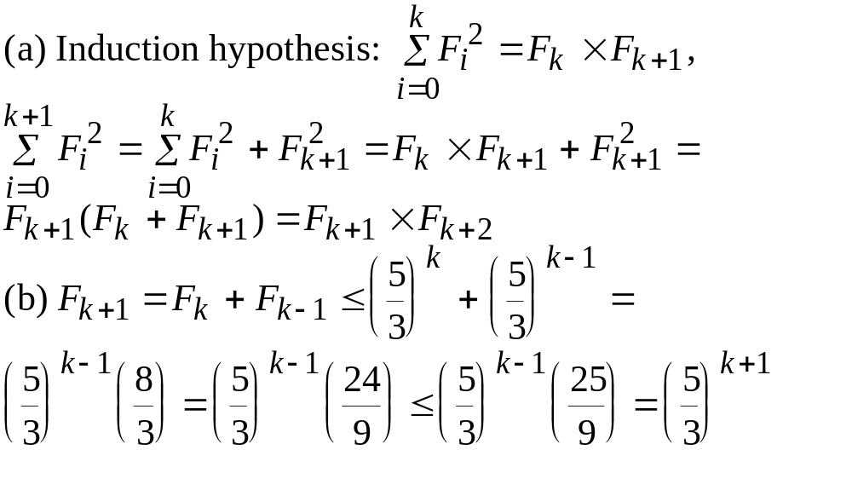
Chapter 4 Properties of the Integers: Mathematical Induction
4.2 Recursive Definitions
Ex. 4.16 The Fibonacci Numbers
Please check out the induction basis for yourselves first.

Slide 17
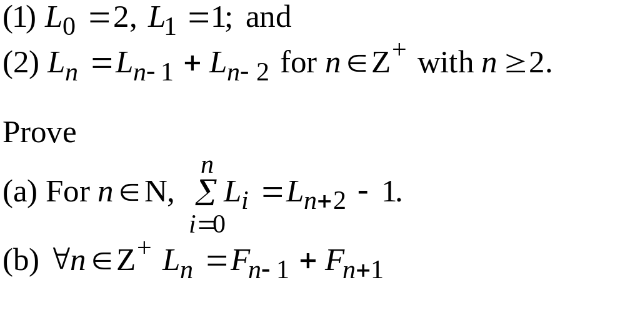
Chapter 4 Properties of the Integers: Mathematical Induction
4.2 Recursive Definitions
Ex. 4.17 The Lucas Number

Slide 18
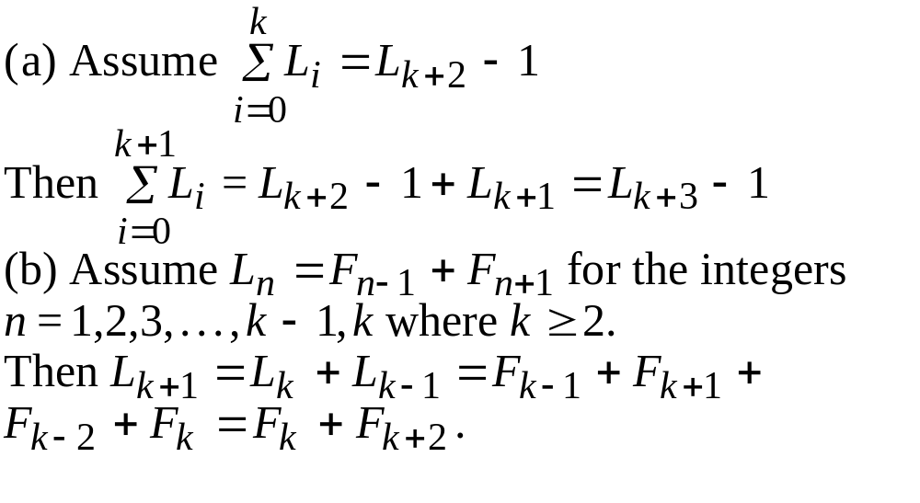
Chapter 4 Properties of the Integers: Mathematical Induction
4.2 Recursive Definitions
Ex. 4.17 The Lucas Number
Please check out the induction basis for yourselves first.

Slide 19
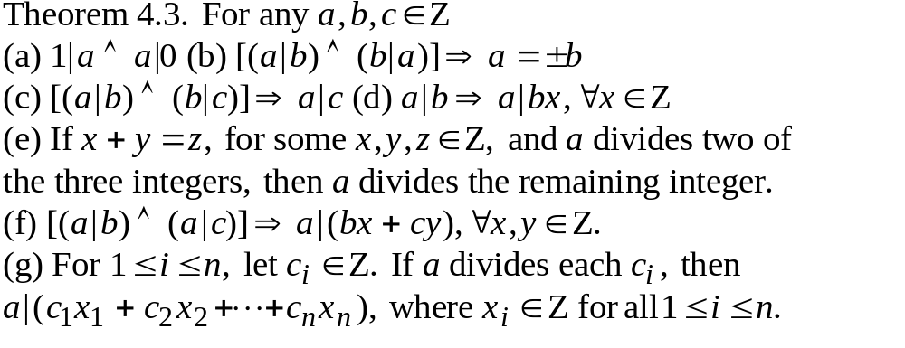
Chapter 4 Properties of the Integers: Mathematical Induction
4.3 The Division Algorithm: Prime Numbers
Def. 4.1 For integers a,b, we say b divides a, and we write b|a,
if there is an integer n, such that a=bn. We say b is a divisor
of a or a is a multiple of b.

Slide 20
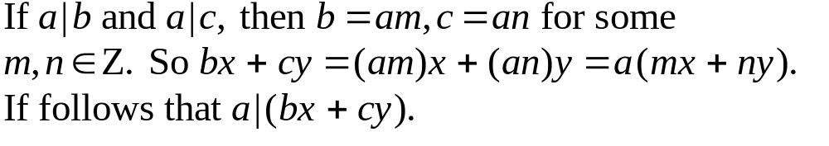
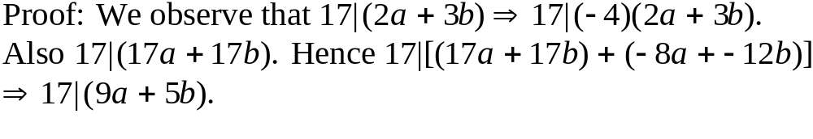
Chapter 4 Properties of the Integers: Mathematical Induction
4.3 The Division Algorithm: Prime Numbers
proof of (f):
Ex. 4.21 Let a,b in Z so that 2a+3b is a multiple of 17. Prove that
17 divides 9a+5b.

Slide 21
Chapter 4 Properties of the Integers: Mathematical Induction
4.3 The Division Algorithm: Prime Numbers
For n in Z⁺ where n>1, n is a prime number if n has only two
divisors, 1 and n. Otherwise n is a composite.
Lemma 4.1. If n in Z⁺ and n is composite, then there is a
prime p such that p|n.
Proof: If not, let S be the set of all composite integers that have no
prime divisors. If S is not empty, then by the well-ordering
principle, S has a least element m. But if m is composite,
m=m₁m₂ with 1<m₁<m and 1<m₂<m. Since m₁ is not in S, m₁ is
a prime or divisible by a prime, which means m is also divisible
by a prime, a contradiction.
lemma, theorem, corollary

Slide 22
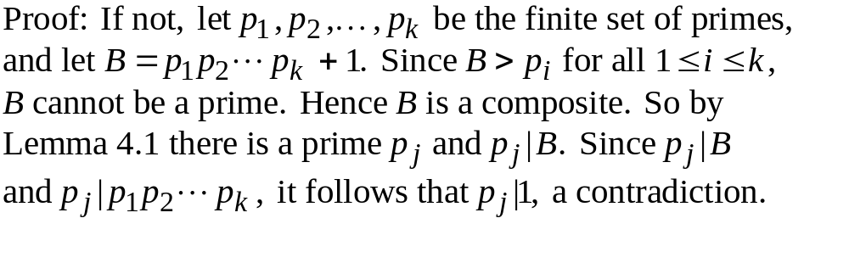
Chapter 4 Properties of the Integers: Mathematical Induction
4.3 The Division Algorithm: Prime Numbers
Theorem 4.4 (Euclid) There are infinitely many primes.

Slide 23
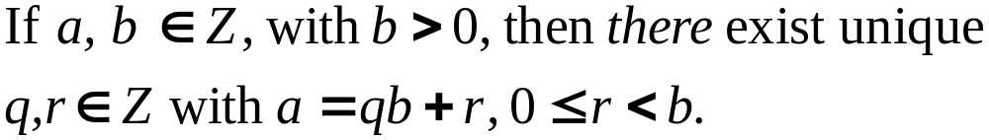
Chapter 4 Properties of the Integers: Mathematical Induction
4.3 The Division Algorithm: Prime Numbers
Theorem 4.5 (The Division Algorithm)
a: dividend
b: divisor
q: quotient
r: remainder

Slide 24
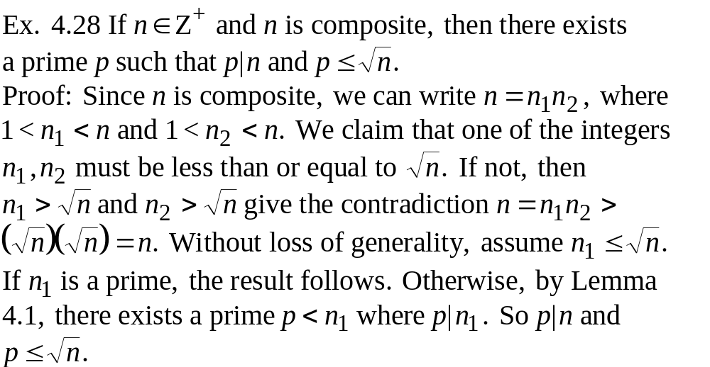
Chapter 4 Properties of the Integers: Mathematical Induction
4.3 The Division Algorithm: Prime Numbers

Slide 25
Chapter 4 Properties of the Integers: Mathematical Induction
4.4 The Greatest Common Divisor: the Euclidean Algorithm
Def. 4.2 For a, b in Z, a position integer c is said to be a common
divisor of a and b if c|a and c|b.
Def 4.3 Greatest Common Divisor
For any common divisor d of a and b, we have d|c. Then
c is a greatest common divisor of a and b.
Theorem 4.6 For any a,b in Z⁺, there exists a unique c in Z⁺
that is the greatest common divisor of a and b.

Slide 26
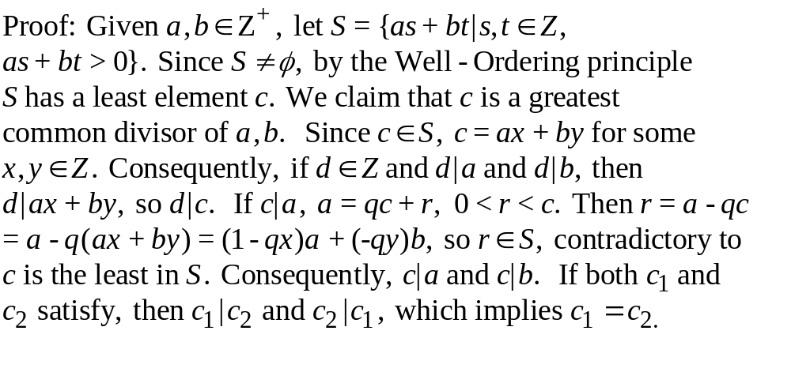
Chapter 4 Properties of the Integers: Mathematical Induction
4.4 The Greatest Common Divisor: the Euclidean Algorithm
(existence and uniqueness)

Slide 27
Chapter 4 Properties of the Integers: Mathematical Induction
4.4 The Greatest Common Divisor: the Euclidean Algorithm
From Theorem 4.6, gcd(a,b) is the smallest positive integer we
can write as a linear combination of a and b.
Integers a and b are called relative prime when gcd(a,b)=1.
That is, when there exist x,y in Z with ax+by=1.
Ex. 4.30 Since gcd(42,70)=14, we can find x,y in Z with
42x+70y=14, or 3x+5y=1. By inspection, x=2, y=-1 is a
solution. But, general solution? x=2-5k, y=-1+3k or
x=2+5k, y=-1-3k..

Slide 28
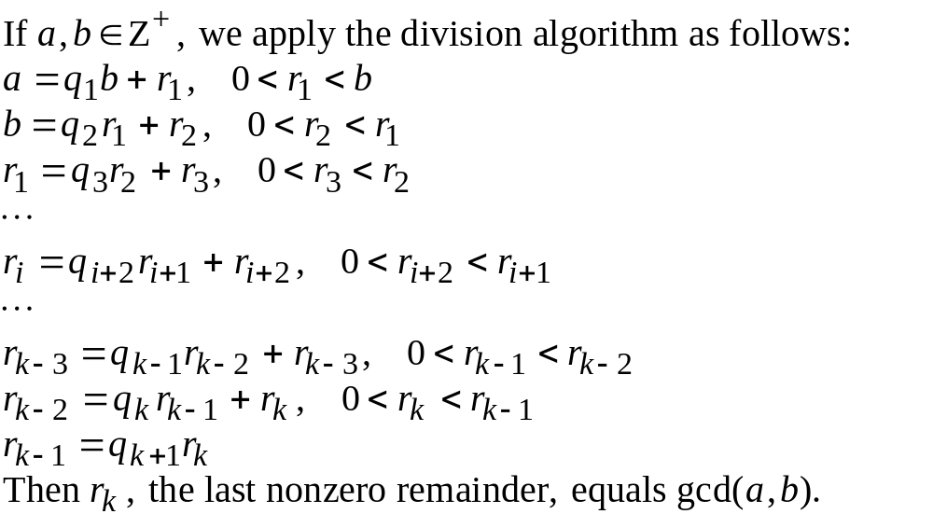
Chapter 4 Properties of the Integers: Mathematical Induction
4.4 The Greatest Common Divisor: the Euclidean Algorithm
Theorem 4.7 Euclidean Algorithm

Slide 29
Chapter 4 Properties of the Integers: Mathematical Induction
4.4 The Greatest Common Divisor: the Euclidean Algorithm
Ex. 4.31 gcd(250,111)=?
gcd(250,111)=1, what is x, and y such
that 250x+111y=1?
250 111
222
28
84
27
27
1
*2
1=28-1(27)=28-1[111-3(28)]=
(-1)111+4(28)=(-1)111+4[250-2(111)]
=4(250)+(-9)(111)
*3
*1
x=4+111k, y=-9-250k

Slide 30
Chapter 4 Properties of the Integers: Mathematical Induction
4.4 The Greatest Common Divisor: the Euclidean Algorithm
Ex. 4.32 For any n in Z⁺, prove that 8n+3 and 5n+2 are relative
prime.
gcd(8n+3,5n+2)=1. But we could also
arrived at this conclusion if we had
noticed that
(8n+3)(-5)+(5n+2)(8)=1
8n+3 5n+2
5n+2
3n+1
3n+1
2n+1
2n+1
n
2n
1

Slide 31
Chapter 4 Properties of the Integers: Mathematical Induction
4.4 The Greatest Common Divisor: the Euclidean Algorithm
Ex. 4.34. Griffin has two unmarked containers. One container
holds 17 ounces and the other holds 55 ounces. Explain how
Griffin can use his two containers to have exactly one ounce.
gcd(17,55)=1, 1=13(17)-4(55), Consequently, Griffin must
fill his smaller container 13 times and empty the contents
into the larger container.

Slide 32
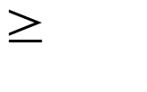
Chapter 4 Properties of the Integers: Mathematical Induction
4.4 The Greatest Common Divisor: the Euclidean Algorithm
Ex. 4.35. Diophantine equation
Find nonnegative integer solutions for 6x+10y=104.
Ans: 3x+5y=52, gcd(3,5)=1, 1=3(2)+5(-1), 52=3(104)+5(-52)
x=104-5k, y=-52+3k, 104-5k 0 and -52+3k 0. So
k=18,19,20.
Theorem 4.8. If a,b,c in Z⁺, the Diophantine equcation ax+by=c
has an integer solution if and only if gcd(a,b) divides c.

Slide 33
Chapter 4 Properties of the Integers: Mathematical Induction
4.4 The Greatest Common Divisor: the Euclidean Algorithm
Def 4.4. For a,b,c in Z⁺, c is called a common multiple of a,b if
c is a multiple of both a and b. Furthermore, c is the least common
multiple if it is the smallest of all positive integers that are common
multiple of a,b. We denote c by lcm(a,b).
Theorem 4.10 For a,b in Z⁺, ab=lcm(a,b)gcd(a,b)

Slide 34
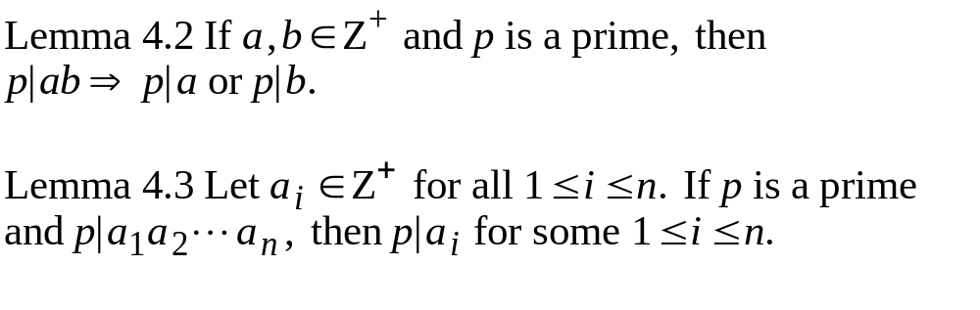
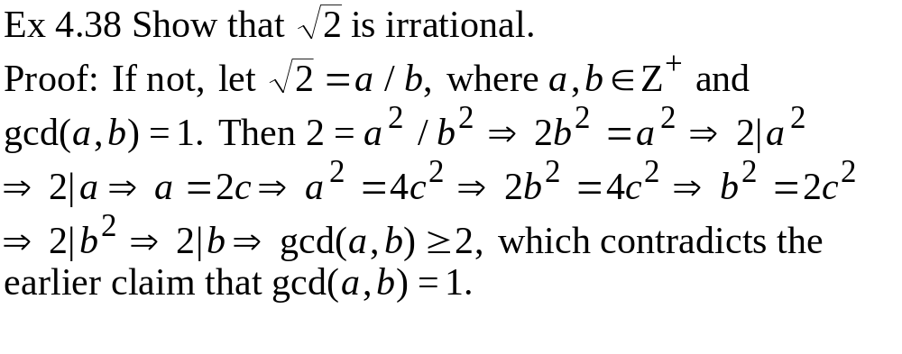
Chapter 4 Properties of the Integers: Mathematical Induction
4.5 The Fundamental Theorem of Arithmetic

Slide 35
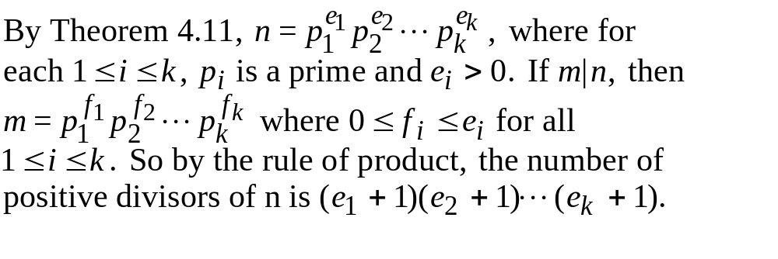
Chapter 4 Properties of the Integers: Mathematical Induction
4.5 The Fundamental Theorem of Arithmetic
Theorem 4.11 (The fundamental theorem of arithmetic) Every
integer n>1 can be written as a product of primes uniquely, up
to the order of the primes.
Ex. 4.41 For n in Z⁺, we want to count the number of positive
divisors of n.

Slide 36
Chapter 4 Properties of the Integers: Mathematical Induction
4.5 The Fundamental Theorem of Arithmetic
Ex. 4.43 Can we find three consecutive positive integers whose
product is a perfect square, that is, do there exist m,n in Z⁺ with
(m)(m+1)(m+2)=n²?
Sol: Suppose m,n do exist. Since gcd(m,m+1)=gcd(m+1,m+2)=1,
so for any prime p, if p|(m+1), then p|m and p|m+2. Furthermore,
if p|(m+1), then p|n². Since n² is a perfect square, the exponents
on p in the prime factorizations of both m+1 and n² must be the
same even integer. So m+1 is a perfect square. And m(m+2) must
be a perfect square too. But m²<m(m+2)<m²+2m+1<(m+1)². So
m(m+2) cannot be a perfect square. m,n do not exist.

Slide 37
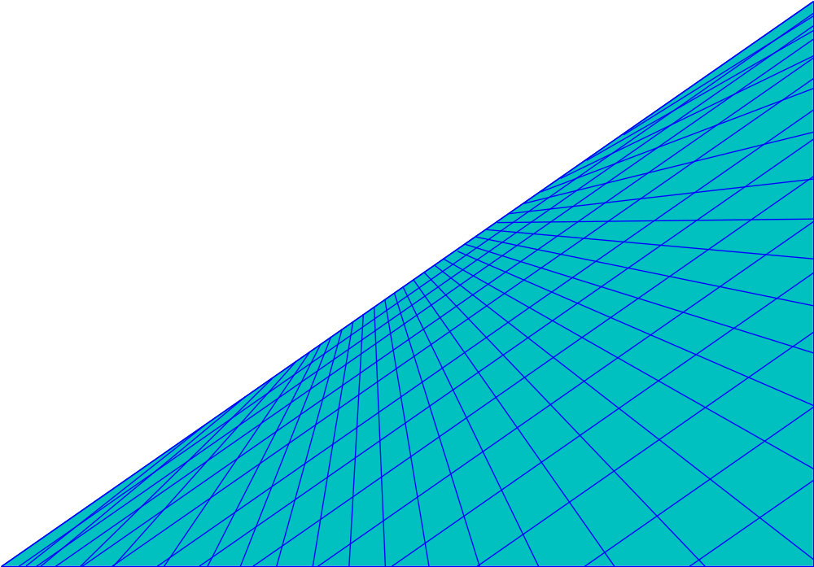

Chapter 4 Properties of the Integers: Mathematical Induction
Exercise:4.1: 8
4.2:10,14
4.3: 18
4.4:6
supplementary: 6,20

